Slide 1
TV Game Shows
October 25th 2011
Presentation LB14
Johan MEDIONI – Maïlis RIBEREAU-GAYON

Slide 2
Plan
Introduction
Part 1 : Examples
Part 2 : Comparison
Part 3 : Analysis
Conclusion

Slide 3
Introduction
Two different cultures : France and Japan
Television : important place in both societies
What about TV Game Shows ? How different are they ? What do they reveal about French and Japanese people ?

Slide 4
Part 1 : Examples Japan
Mainly sports shows
Total commitment
Famous candidates
Lack of limits
No team; every one for himself
Not many rewards

Slide 5


Slide 6


Slide 7
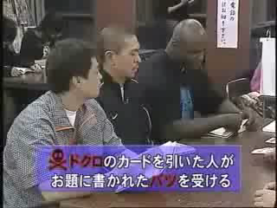

Slide 8


Slide 9
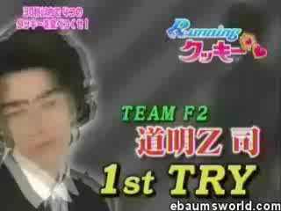

Slide 10


Slide 11
Part 1 : Examples France
Mainly ‘‘intelectual’’ game shows
Static people
Unknown candidates
Moderate games
Teams / one against the anchorman
A lot of money to win

Slide 12
Part 2 : Comparison Sense of limit
Prudishness :
Not a problem in Japan
Much more present in France
Crualty, sadism :
Almost needed in Japan
Rejected in France
Noise, concentration :
Japanese : shouting, moving, many different voices at the same time
France : calm, reserved

Slide 13
Part 2 : Comparison Candidates
Anonymity :
France :
unknown candidates
if celebrities participate, no money for them
Japan :
‘‘aidoru’’ (idol), ‘‘tarento’’ (talents) : people whom job is to be famous, money for them
few unknown poeple
Teams :
France :
Few teams in a show : rarely more than 2
When no team : not too much candidates
Japan :
Almost no team
Plenty of people; messy

Slide 14
Part 2 : Comparison What of similar games ?
Takeshi’s Castle vs. Intervilles
Gakkou e Itou vs. any French quizz game

Slide 15
Part 3 : Analysis
Japanese :
Not showing off => mostly idols participate
‘‘Usual’’ japanese dislike interaction
Really polychronic
French :
Unknown people like their moment of glory
Less polychronic

Slide 16
Conclusion
Real difference between the two cultures.
Japanese game shows begin to be appreciated in Occident (W9 and M6 broadcast Takeshi’s Castle, ‘‘Total Wipeout’’).
Occidental game shows can hardly be adapted in Japan.

Slide 17
Any Questions ?

